Slide 1

Unsupervised learning
Topic modelling with LDA
By
Naveen Reddy Bokka

Slide 2
contents
INTRODUCTION
PREPROCESSING OF RAW DATA
Loading the dataset
Categorizing the attributes
TRAINING THE MODEL WITH LDA
VISUALIZATION :BUSINESS ANALYST
BUSINESS ANALST :TOPIC I
BUSINESS ANALST :TOPIC II
BUSINESS ANALST :TOPIC III
BUSINESS Analysis
VISUALIZATION : CLOUD
CLOUD :TOPIC 1
CLOUD :TOPIC II
CLOUD :TOPIC III
VISUALIZATION : HR
HR :TOPIC I
HR :TOPIC II
HR :TOPIC III
VISUALIZATION : SOFTWARE DEVELOPER
SOFTWARE DEVELOPER :TOPIC I
SOFTWARE DEVELOPER :TOPIC II
SOFTWARE DEVELOPER :TOPIC III
VISUALIZATION : UI / UX
UI / UX :TOPIC I
UI / UX :TOPIC II
UI / UX :TOPIC III

Slide 3
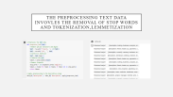
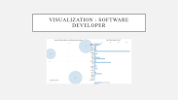
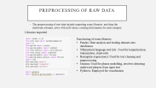
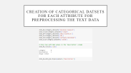
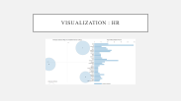
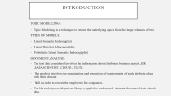
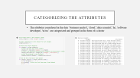
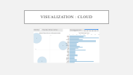
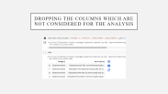
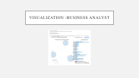
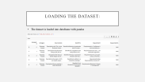
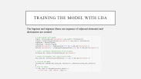
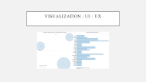
contents

Slide 4
INTRODUCTION
TOPIC MODELLING:
Topic Modelling is a technique to extract the underlying topics from the large volumes of text.
TYPES OF MODELS:
Latent Semantic Indexing(lsi)
Latent Dirichlet Allocation(lda)
Probalisitc Latent Semantic Indexing(plsi)
DOCUMENT ANALYSIS:
The text data considered involves the information about attributes business analyst ,HR ,DATASCIENTIST ,CLOUD , UI/UX .
The analysis involves the examination and extraction of requirements of each attribute along with their domain
Skill in order to recruit the employees for companies .
The lda technique with genism library e applied to understand interpret the textual data of each data.

Slide 5
OVERVIEW OF NATURAL LANGUAGE PROCESSING(NLP) IN DOCUMENT ANALYSIS:
Natural language processing(nlp) is a field of ai which focuses on communication human and machine languages .The nlp techniques are employed for preprocessing ,analysing , and extracting meaningful information from textual data in a document analysis. The tasks performed such as tokenization, lemmatization, topic modelling
LET'S HAVE A GLANCE OF WHAT TOKENIZATION,LEMMETIZATION,STOPWARDS REMOVAL:
TOKENIZATION: It is a process of splitting down the text in a document into individual components called tokens. Tokens can be data with phrases, meaningful words or elements.
LEMMETIZATION:It is the process of reduction of words into base form simply which give the same meaning which involves elimination of inflections and bring words into canonical form which makes a pivotal role in accurate analysis.
STOPWARDS REMOVAL:It is the process of filtering out words which are insignificant and irrelevant(eg and,the ,is).

Slide 6
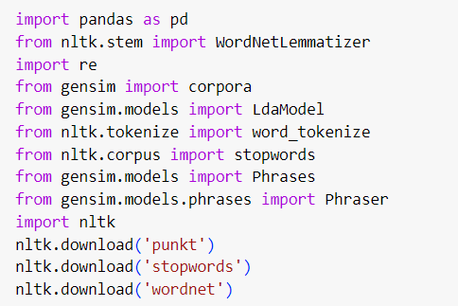

PREPROCESSING OF RAW DATA
The preprocessing of raw data include importing some libraries and drop the irrelevant columns ,rows with null values, creating dictionaries for each category
Libraries imported
Functioning of some libraries:
Pandas: Data analysis and loading datasets into dataframes
Nltk(natural language tool kit) : Used for lemmitization, tokenization, stopwords.
Re(regular expressions): Used for text cleaning and preprocessing.
Gensim: Used for phrase modelling, involves detecting multiword phrases from input text
Pyldavis: Employed for visualization

Slide 7
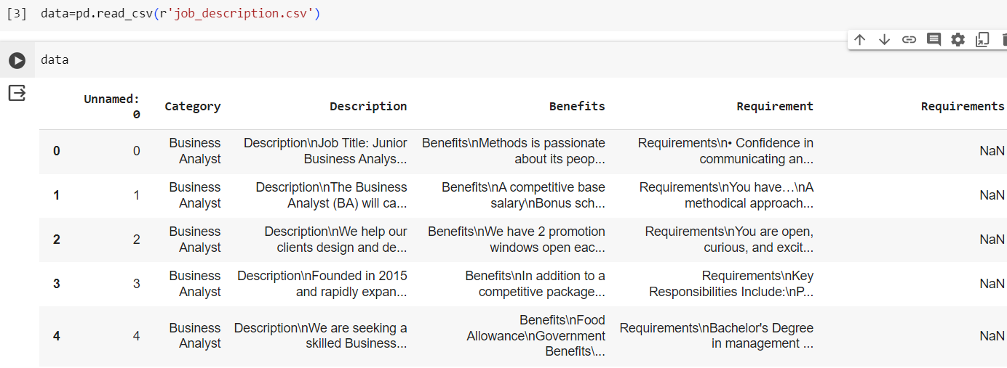
Loading the dataset:
The dataset is loaded into dataframe with pandas

Slide 8
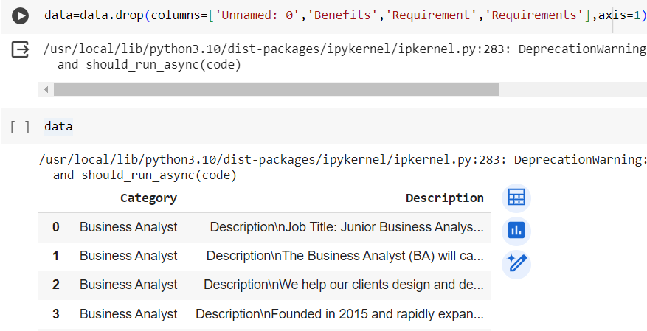
Dropping the columns which are not considered for the analysis

Slide 9
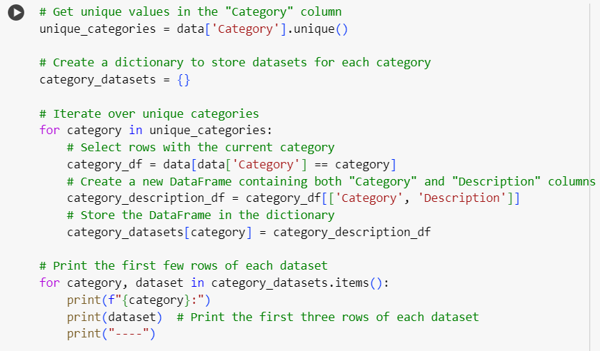
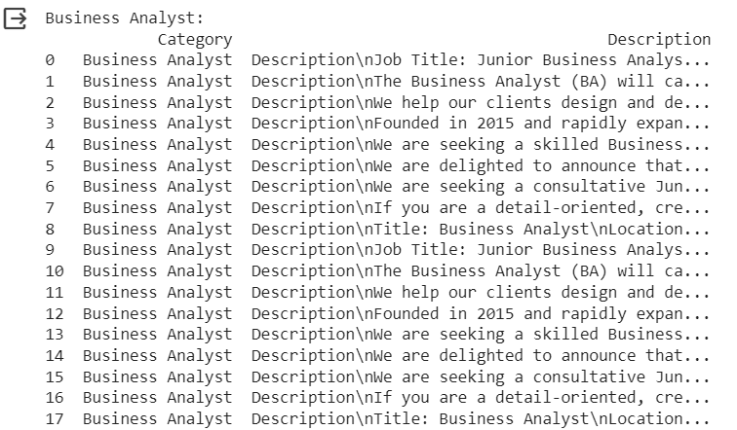
Categorizing the attributes
The attributes considered in the data 'business analyst', 'cloud', 'data scientist', 'hr', 'software developer', 'ui/ux’ are categorized and grouped in the form of a cluster

Slide 10
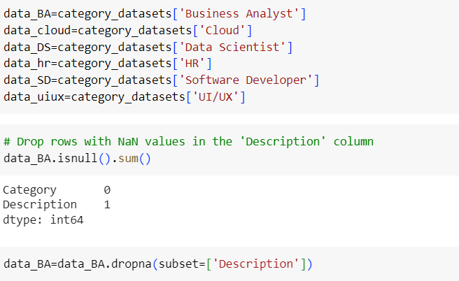
CREATION OF CATEGORICAL DATSETS FOR EACH ATTRIBUTE FOR PREPROCESSING THE TEXT DATA

Slide 11
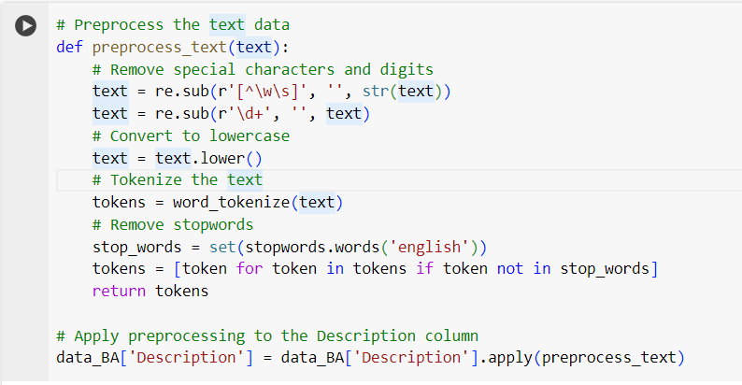
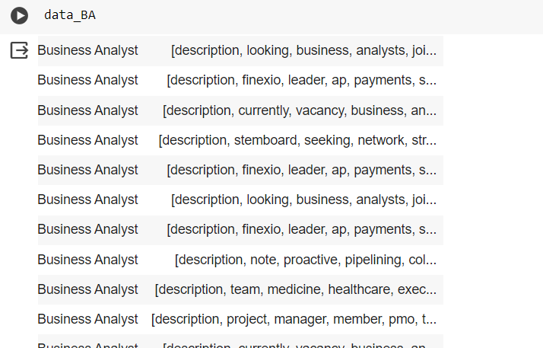
THE PREPROCESSING TEXT DATA INVOVLES THE REMOVAL OF STOP WORDS AND TOKENIZATION,LEMMETIZATION

Slide 12
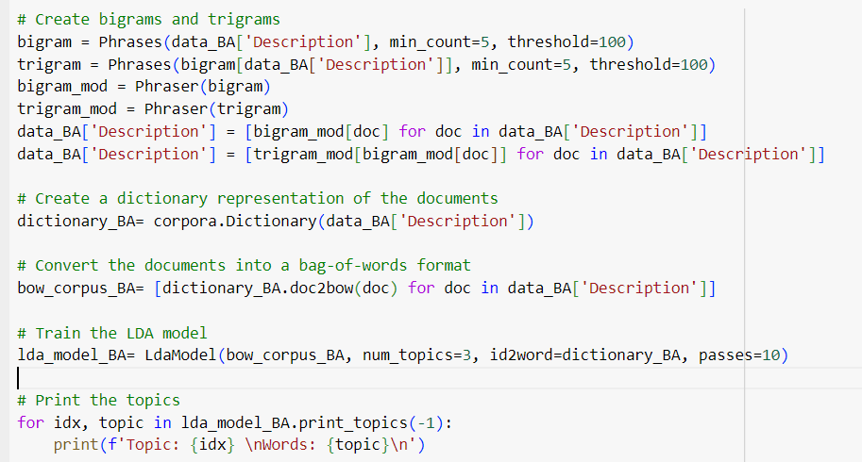
TRAINING THE MODEL WITH LDA
The bigrams and trigrams (these are sequence of adjacent elements) and dictionaries are created.

Slide 13
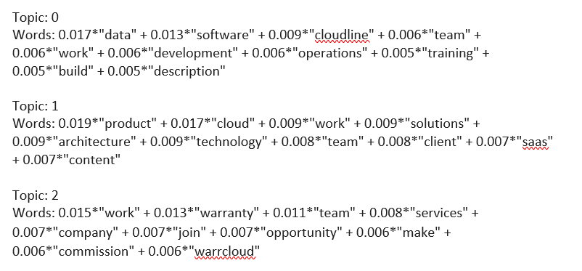

Slide 14
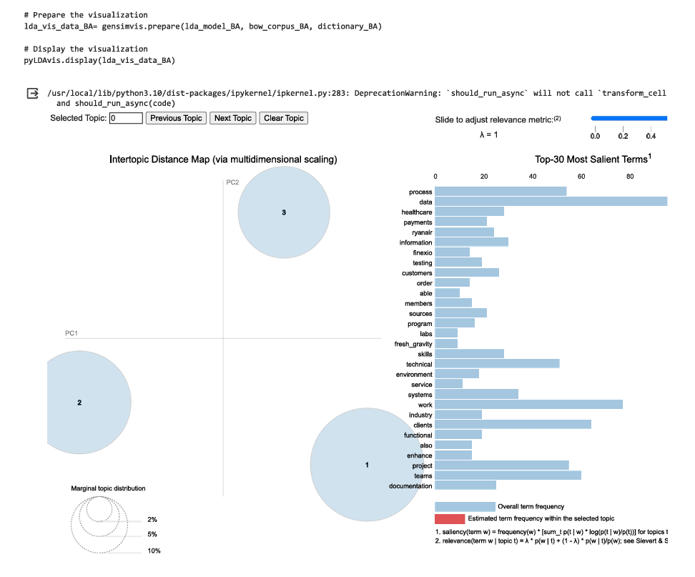
VISUALIZATION :BUSINESS ANALYST

Slide 15
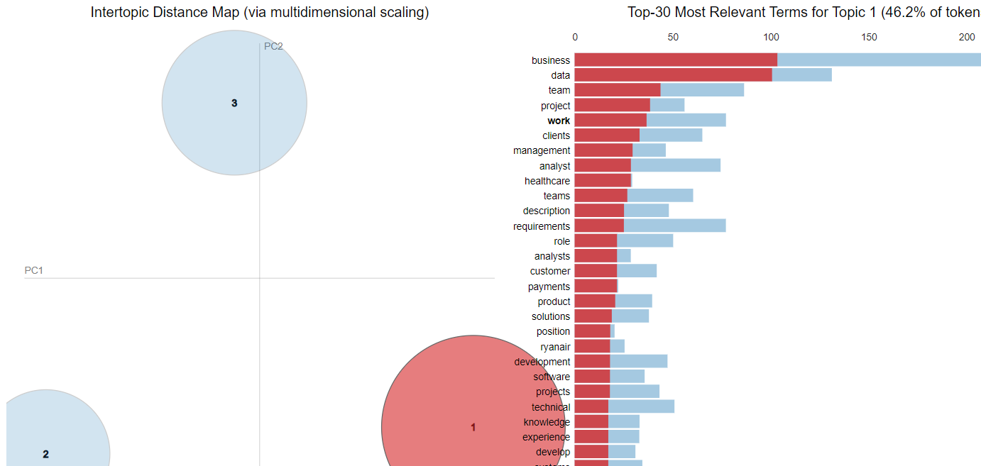
BUSINESS ANALST :TOPIC I

Slide 16
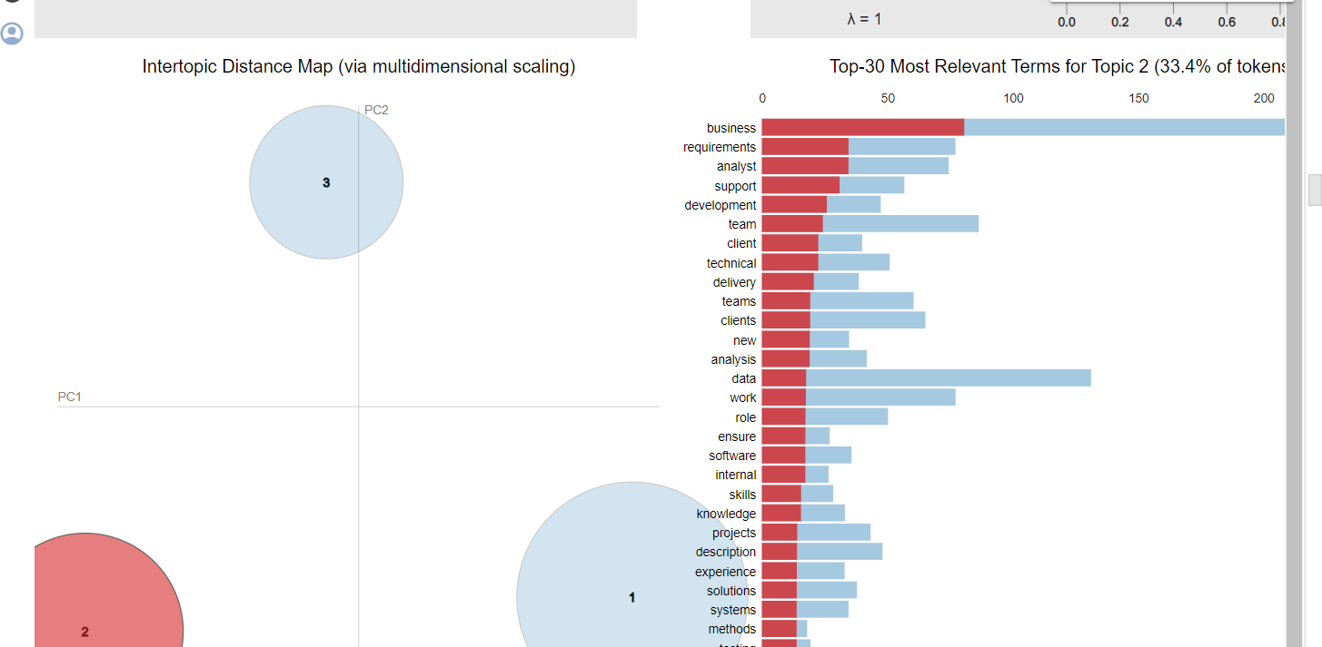
BUSINESS ANALST :TOPIC II

Slide 17
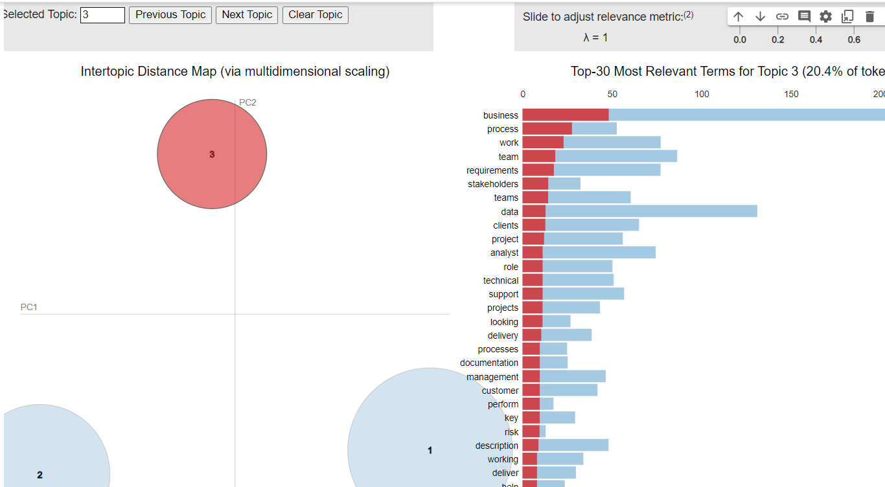
BUSINESS ANALST :TOPIC III

Slide 18
BUSINESS ANALST
Inference 1:the business analyst is been not only recruited based on their technical skills like python ,sql and management skills but also considering some more crucials aspects like his knowledge on the domain business and client management.
Inference 2 :the most of the business analysts are recruited in the domain of health care.

Slide 19
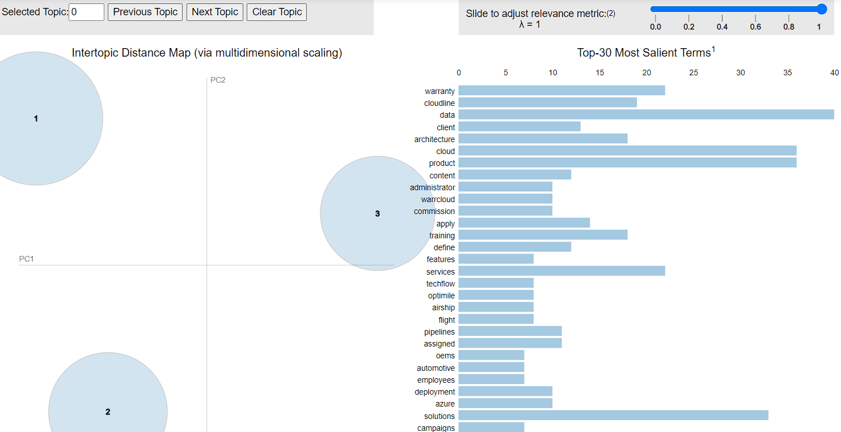
VISUALIZATION : CLOUD

Slide 20
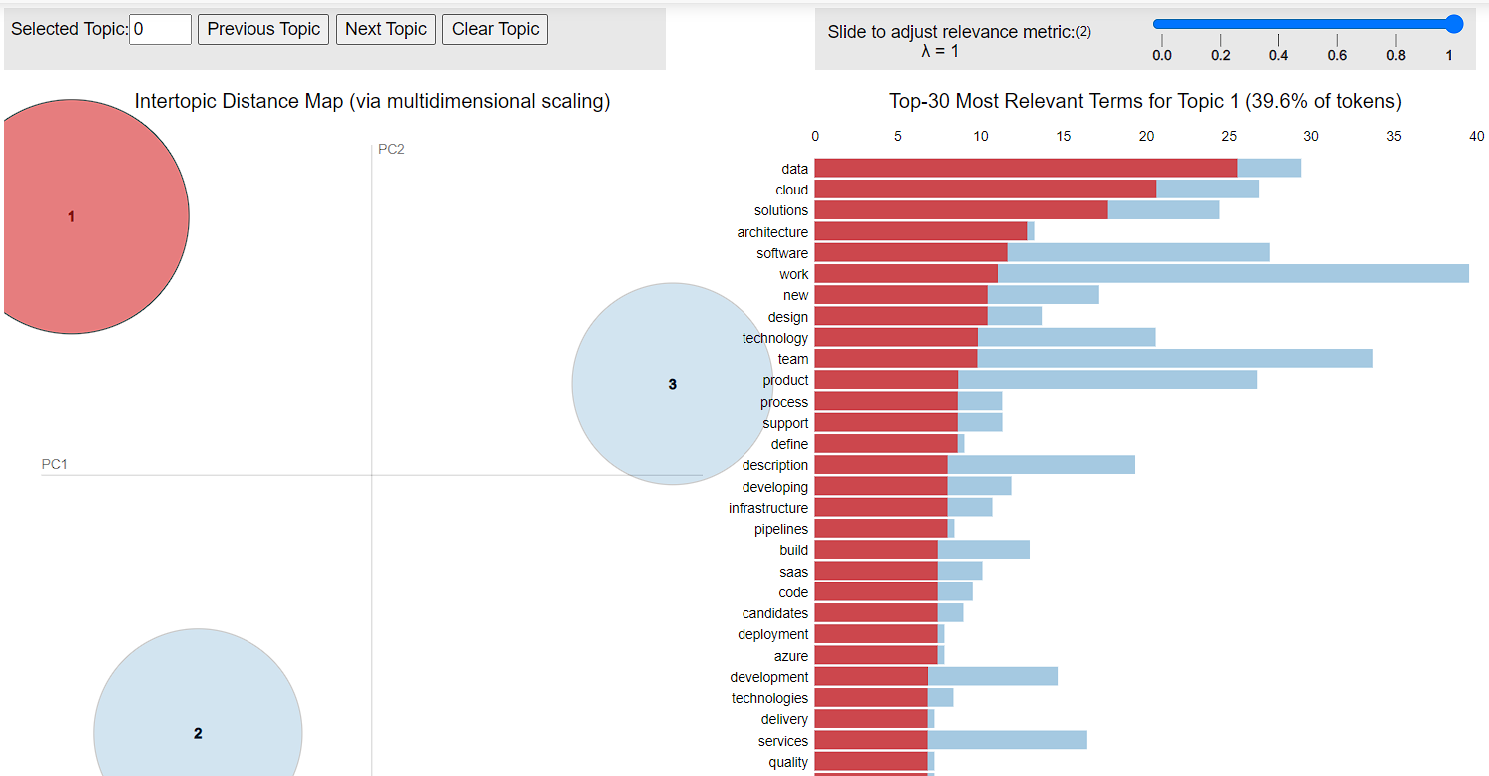
CLOUD :TOPIC 1

Slide 21
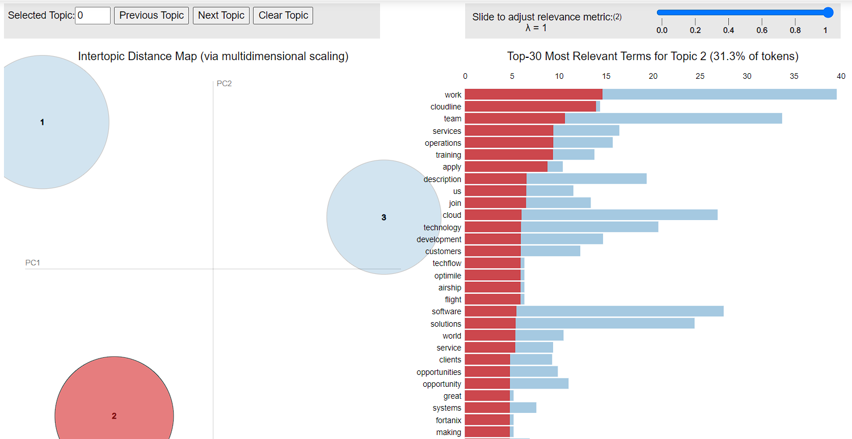
CLOUD :TOPIC II

Slide 22
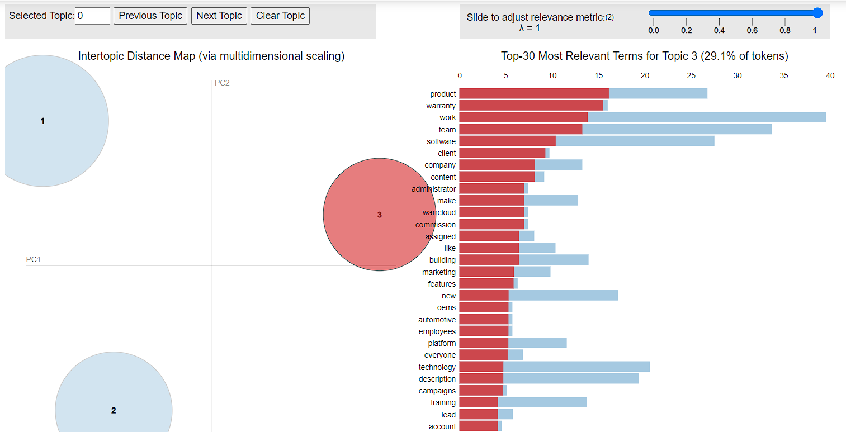
CLOUD :TOPIC III

Slide 23
Cloud
Inference 1 :The topic 1 with 39.6 percent tokens is considered .the cloud domain engineers are recruited based on their core knowledge on data and cloud
Inference 2 :Apart of the technical skills ,they are also recruited based on the analytical skills and team work and adaptability.

Slide 24
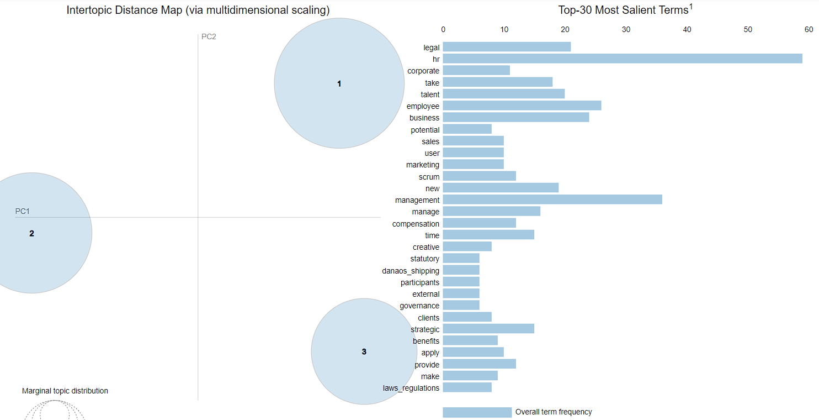
VISUALIZATION : HR

Slide 25
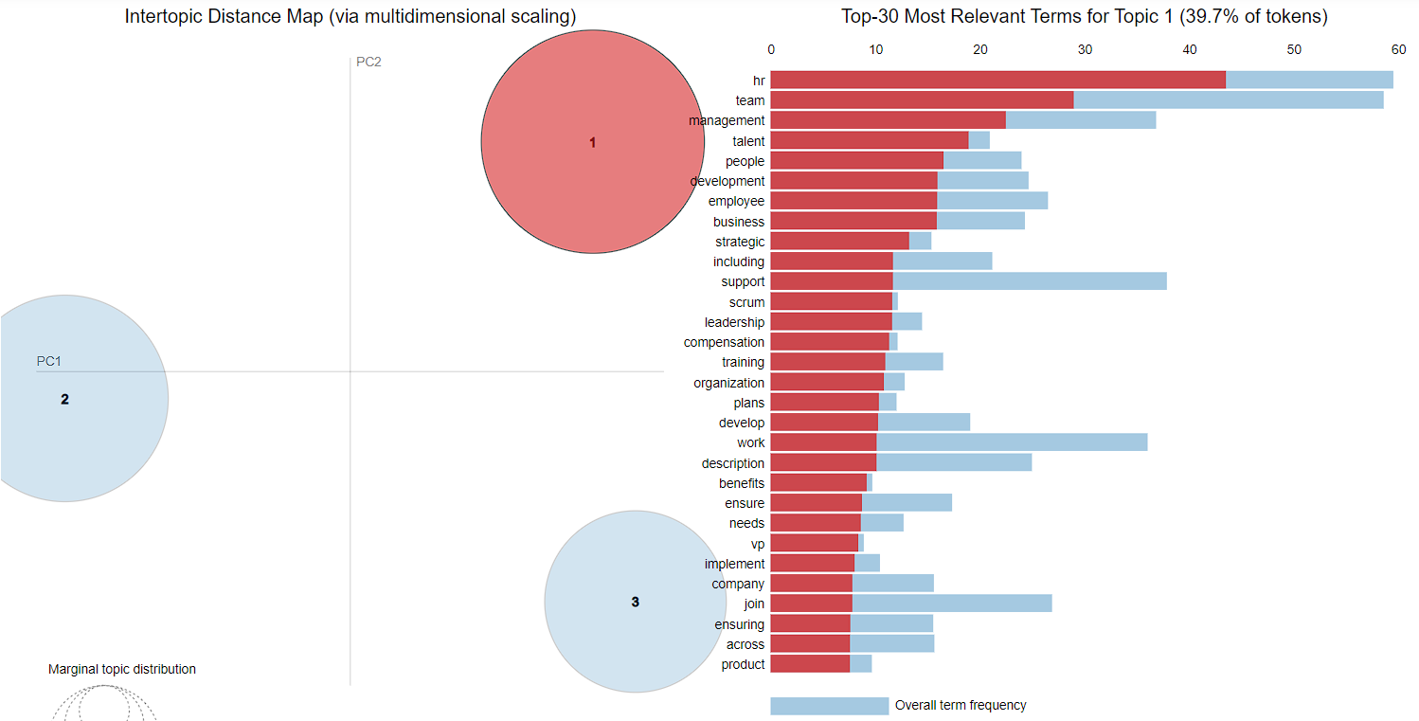
HR :TOPIC I

Slide 26
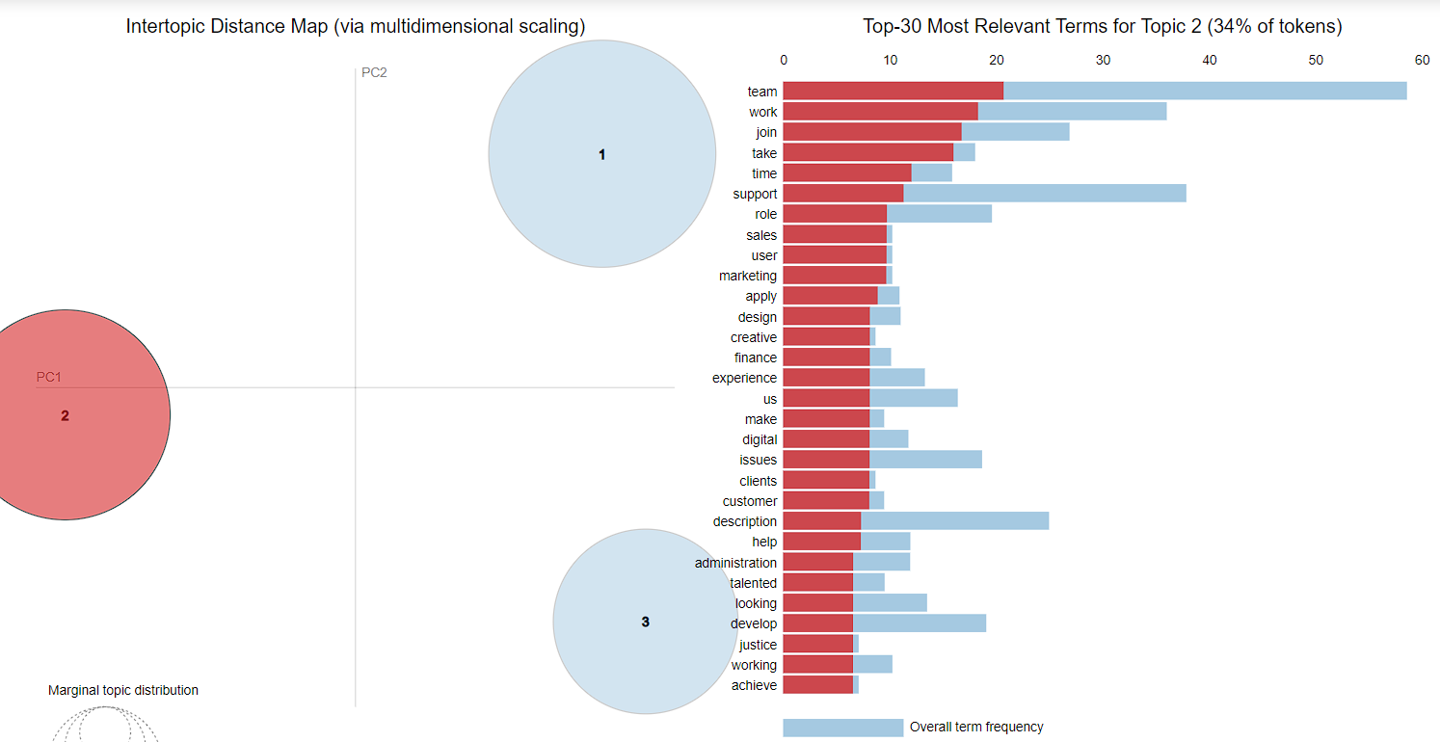
HR :TOPIC II

Slide 27
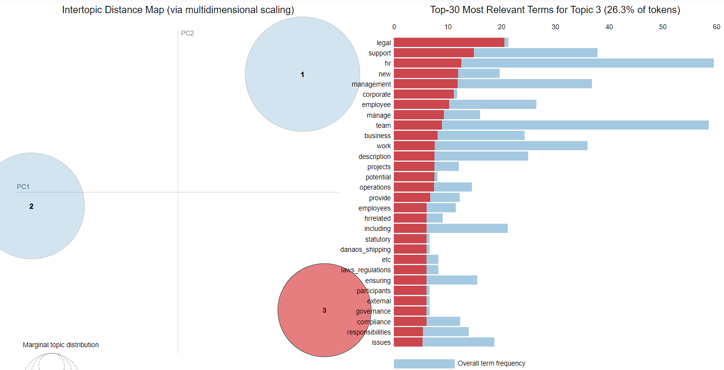
HR :TOPIC III

Slide 28
hr
Inference I :The people in HR are being recruited based on the HR skills pivotally. They must have good management and leadership skills .They should have partially knowledge on every domain and able to assess the candidate .

Slide 29
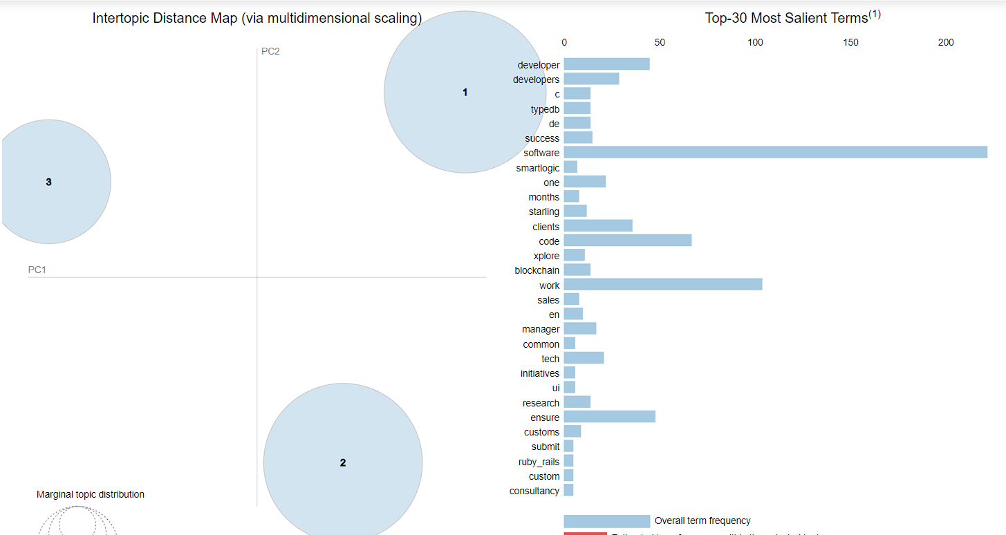
VISUALIZATION : SOFTWARE DEVELOPER

Slide 30
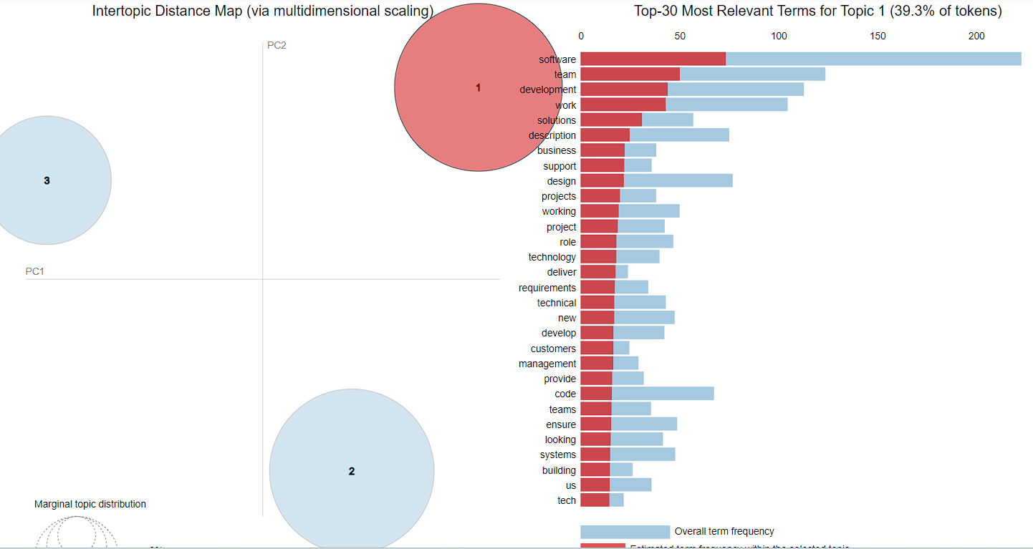
SOFTWARE DEVELOPER :TOPIC I

Slide 31
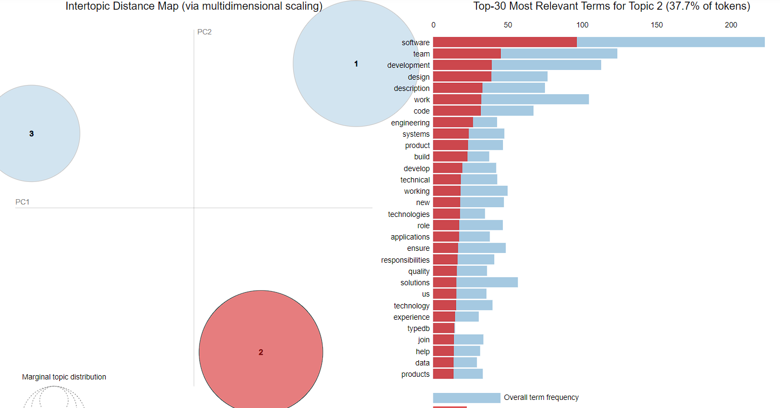
SOFTWARE DEVELOPER :TOPIC II

Slide 32
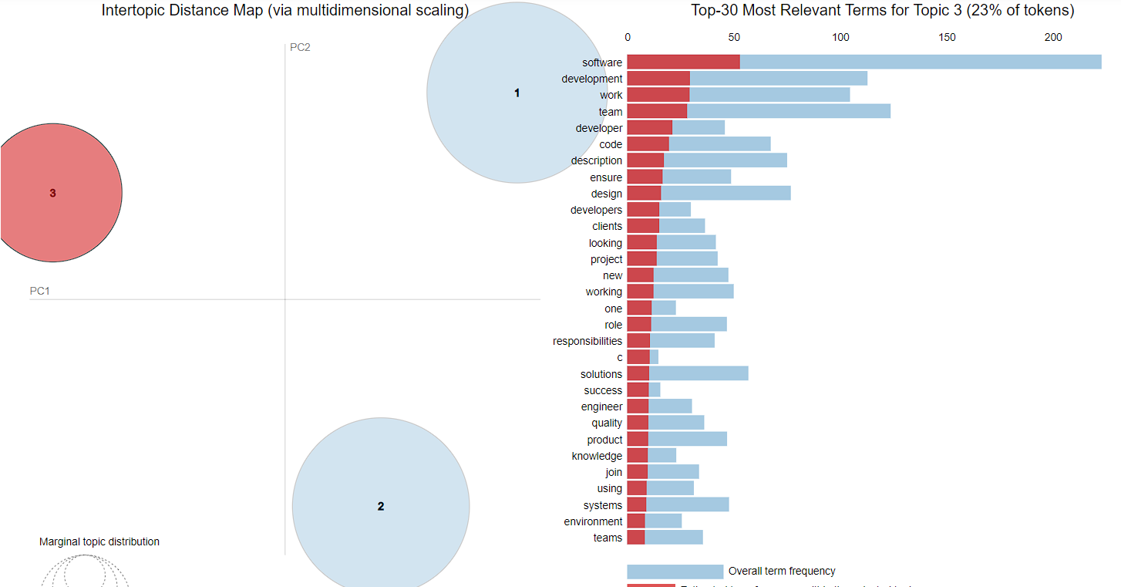
SOFTWARE DEVELOPER :TOPIC III

Slide 33
SOFTWARE DEVELOPER
Inference I : THE SOFTWARE DEVELOPER ARE BEING RECRUITED BASED ON THEIR SOFTWARE DEVELOPMENT SKILLS AND THEIR COLLABORATIVE WORK TOWARDS THE TASK MANAGEMENT.
Inference II: MOST OF THE SOFTWARE DEVELOPERS ARE HIRED IN THE DOMAIN OF SOFTWARE FIELD.

Slide 34
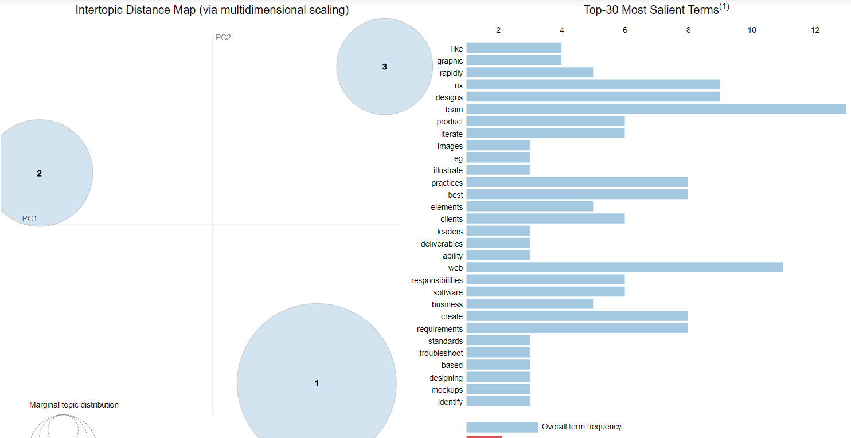
VISUALIZATION : UI / UX

Slide 35
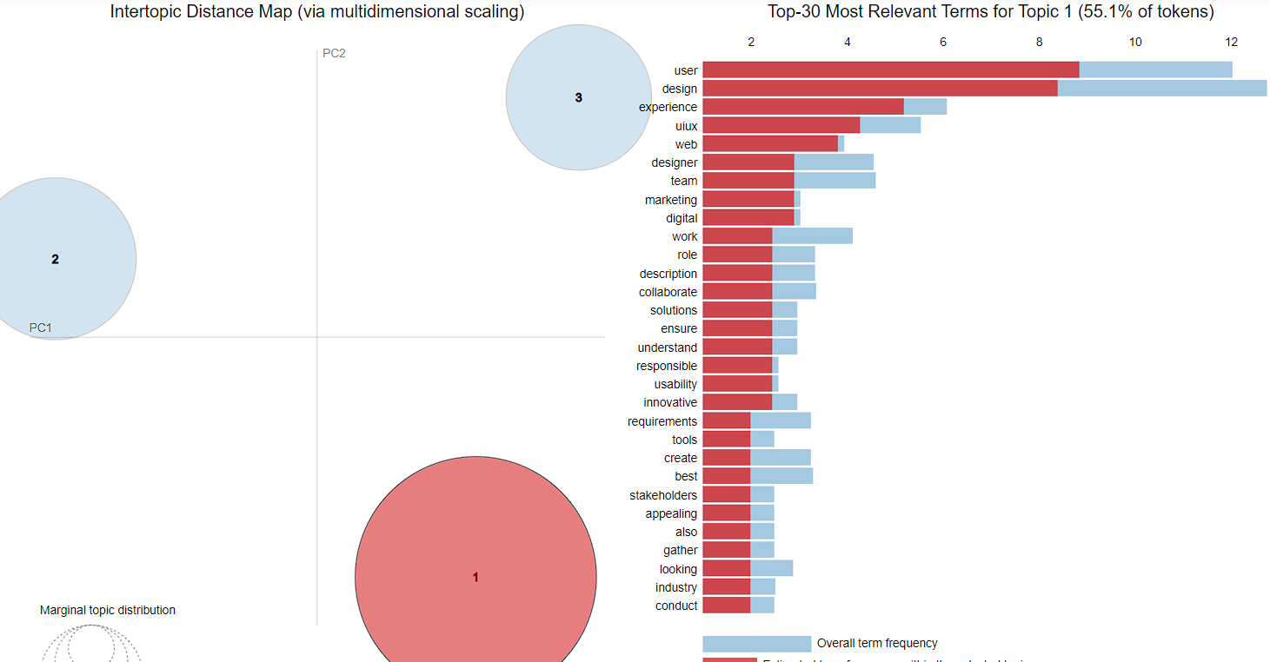
UI / UX :TOPIC I

Slide 36
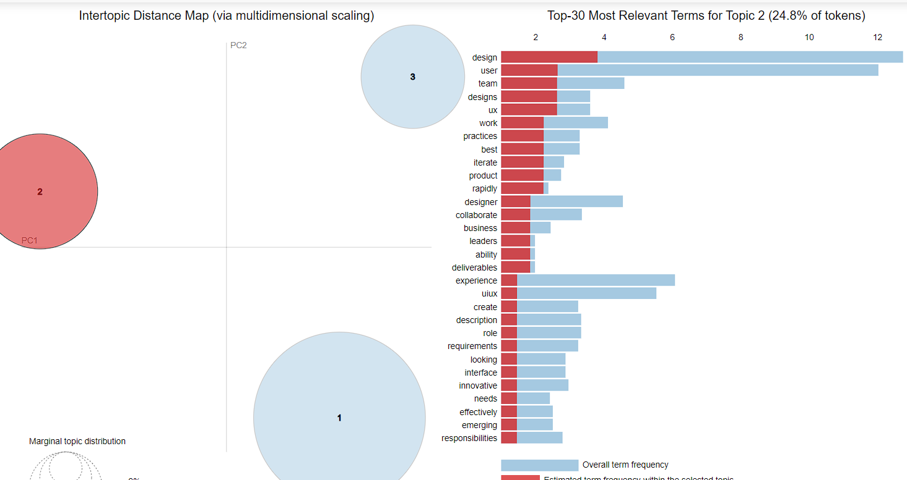
UI / UX :TOPIC II

Slide 37
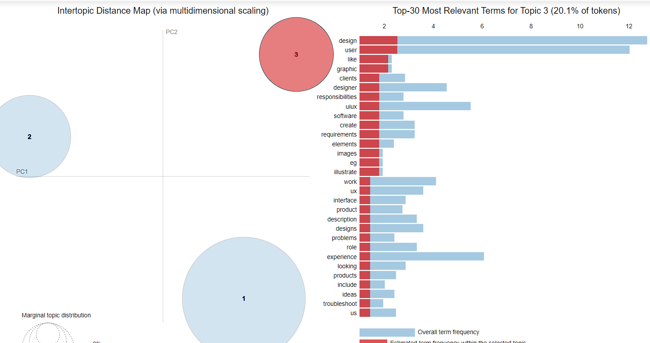
UI / UX :TOPIC III

Slide 38
UI / UX
Inference I : THE UI/UX DEVELOPERS ARE BEING RECRUITED BASED ON THEIR SKILL TOWARS DESIGNING AND PROVIDING AN EFFICIENT USER INTERFACE FOR THE CLIENT.
Inference II: MOST OF THE UI/UX DEVELOPERS ARE HIRED IN THE DESIGNING SKILL.

Slide 39


